Slide 1

Network Design and Security Implementation of a Hospital System
PREPARED BY
1.Mohamed Abdo Abdel Sattar 2. Abdallah Gamal Mobarak 3.Ousaid Ashraf Mosbah
4.Ahmed Ghaly Gomaa 5.Mohamed Ahmed Khalil 6.Zeyad Mohamed Abdelwaris

Slide 2
Agenda
Network Design.
Basic settings and SSH to all routers and switches.
DHCP
NTP & SYSLOG
VLANS.
Subnetting Ips.
OSPF.

Slide 3
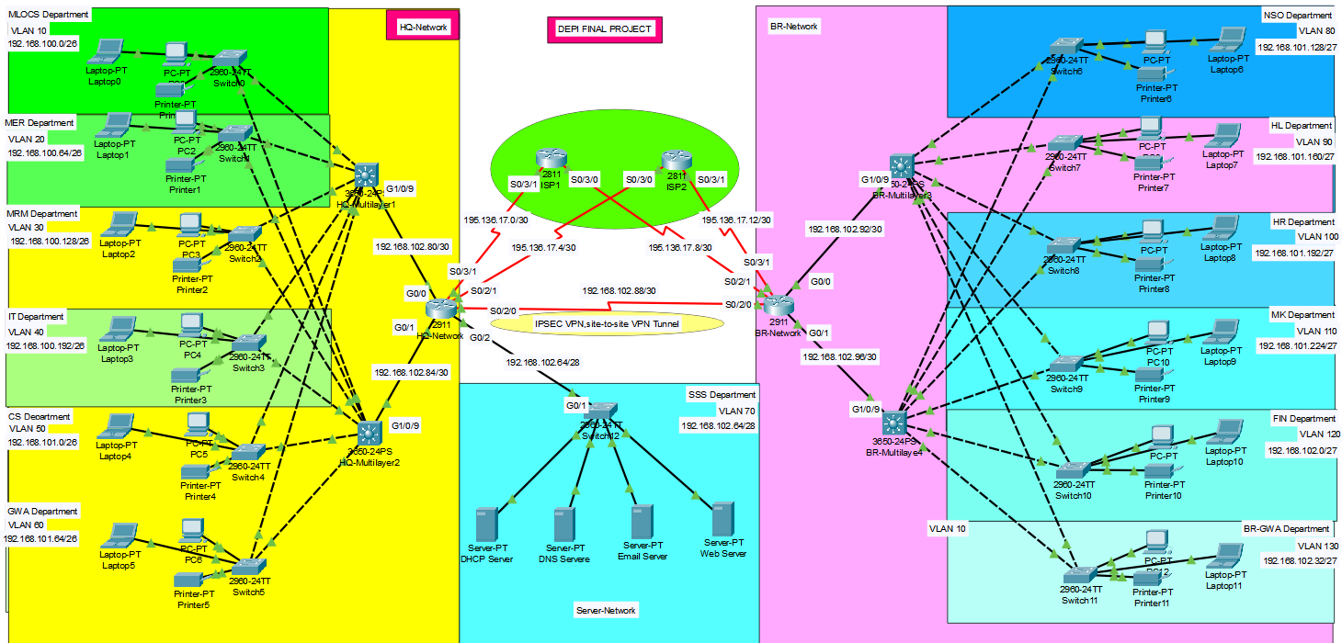
Network Design

Slide 4
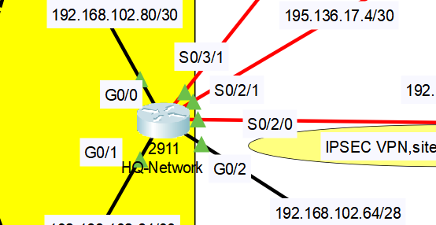
Basic Settings
Commands
en
conf t
hostname BR-Router
enable password cisco
banner motd #No Unauthorised Access!!!#
no ip domain lookup
line console 0
password cisco
login
exit
service password-encryption

Slide 5
SSH
SSH (Secure Shell) is a cryptographic network protocol used for securely accessing and managing devices over an unsecured network. It provides encrypted communication between a client and a server, ensuring confidentiality, data integrity, and authentication. SSH is commonly used for remote login
Commands
ip domain name cisco.net
username admin password cisco
crypto key generate rsa
1024
line vty 0 15
login local
transport input ssh
exit

Slide 6
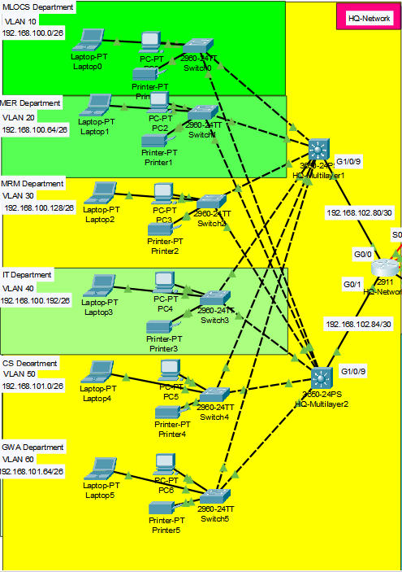
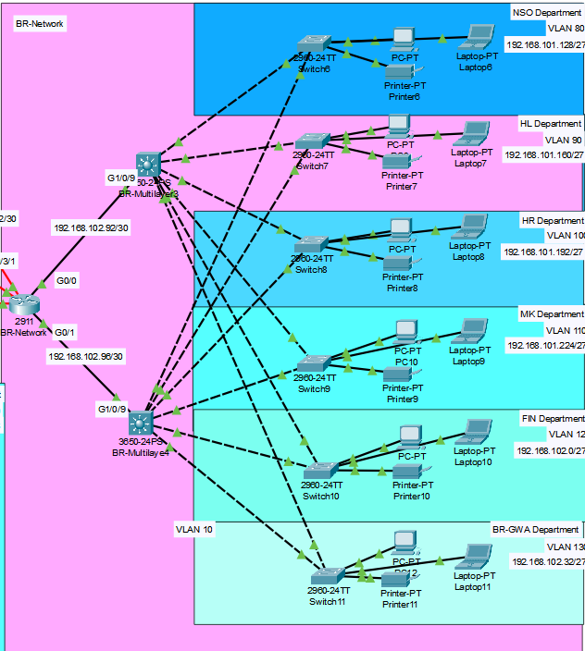
VLANS
Commands
HQ-Network Side
vlan 10
vlan 20
vlan 30
vlan 40
vlan 50
vlan 60
exit
int ra g 1/0/1-7
switchport mode trunk
exit
BR_Network Side
vlan 80
vlan 90
vlan 100
vlan 110
vlan 120
vlan 130
exit
int ra g 1/0/1-7
switchport mode trunk
exit

Slide 7
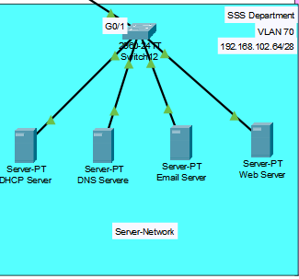
Servers’ room vlan
Commands
Vlan 70
name SSS
exit
int ra g0/1-2
switchport mode trunk
exit
int ra f0/1-24
switchport mode access
switchport access vlan 70
exit

Slide 8
DHCP
DHCP (Dynamic Host Configuration Protocol) is a network protocol used to automatically assign IP addresses to devices connected to a network. It simplifies the management of IP addresses by dynamically allocating an IP to each device, instead of requiring manual configuration for each one.

Slide 9
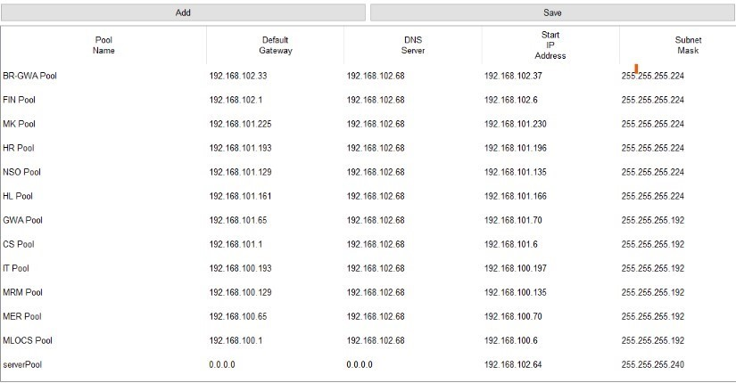
DHCP
DHCP Pool Configuration:
This table shows the configuration of multiple DHCP pools for different departments and services in a network. Each pool defines the range of IP addresses that the DHCP server can assign to devices within that specific department

Slide 10
NTP
NTP (Network Time Protocol):
NTP is a protocol used to synchronize the time and date across devices on a network. It ensures that all devices share the same accurate time, which is critical for systems that depend on synchronized timing.

Slide 11

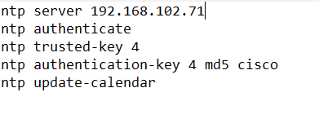
NTP Configuration:
Time And Date Before NTP
Time And Date After NTP

Slide 12
SYSLOG
SYSLOG is a standard protocol used for sending and receiving log messages from network devices and servers. It allows devices to send log data to a centralized log server, which is essential for monitoring and troubleshooting network activity.

Slide 13
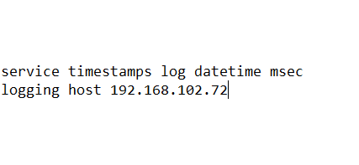
SYSLOG
SYSLOG COMMAND:
] 192.168.102.72 [ THAT IS THE IP FOR SYSLOG SERVER.

Slide 14
EXAMPLE OF SYSLOG
The SYSLOG feature is crucial for tracking login activities on network devices. In this example:
Timestamp: Displays the exact time the login event occurred, providing precise tracking of user access.
Hostname (192.168.102.90): Identifies the device where the login activity took place.
Log Messages:
Configuration Change: The message "%SYS-5-CONFIG_I: Configured from console by console" indicates that a configuration change was made via the device's console, highlighting administrative actions.
Logging Initiation: The message "%SYS-6-LOGGINGHOST_STARTSTOP: Logging to host 192.168.102.72 port 514 started - CLI initiated" indicates that the device began sending SYSLOG messages to another host at 192.168.102.72 using port 514, commonly used for SYSLOG servers.

Slide 15

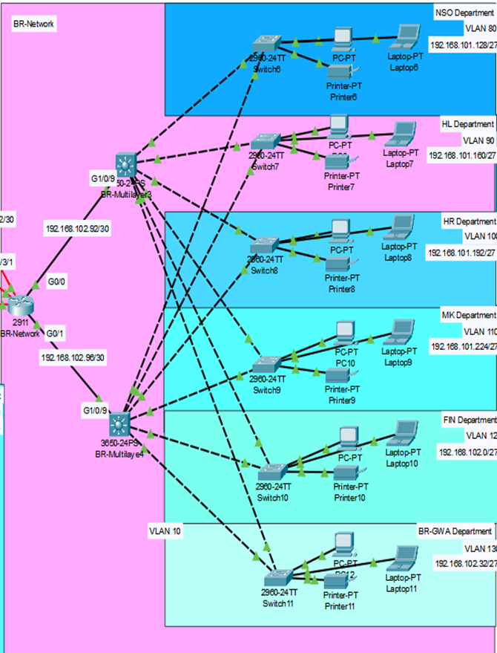
IP subnetting
Benefits of Subnetting:
Efficient Use of IP Space: Prevents wasting IP addresses by allocating appropriate sizes for different segments.
Improved Network Performance: Reduces broadcast domains, limiting traffic within subnets.
Enhanced Security: Allows better control and segmentation of network traffic.

Slide 16
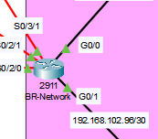
OSPF
Commands
BR-Router(config)#router ospf 10
BR-Router(config-router)#network 192.168.102.92 0.0.0.3 area 0
BR-Router(config-router)#network 192.168.102.96 0.0.0.3 area 0
BR-Router(config-router)#network 192.168.102.88 0.0.0.3 area 0
BR-Router(config-router)#network 195.136.17.8 0.0.0.3 area 0
BR-Router(config-router)#network 195.136.17.12 0.0.0.3 area 0
BR-Router(config-router)#
BR-Router(config-router)#ex
BR-Router(config)#
BR-Router(config)#ip route 0.0.0.0 0.0.0.0 195.136.17.14
BR-Router(config)#ip route 0.0.0.0 0.0.0.0 195.136.17.10 70
BR-Router(config)#do wr

Slide 17
Thank you

